Slide 1
Carbon Sequestration - Crown Mineral Activity
Government of Alberta
Welcome!
to the
Carbon Sequestration (CS) -
Crown Mineral Activity (CMA)
Online Training Course
In this module, you will learn how to:
Create and submit CS CMA application
Upload required geological information
Review and retrieve documents

Slide 2
Carbon Sequestration - Crown Mineral Activity
Government of Alberta
Revisions Table
Date | Revisions Type | Page Number
December 16, 2024 | Initial Creation

Slide 3
Carbon Sequestration - Crown Mineral Activity
Government of Alberta
INTRODUCTION
The Crown Mineral Activity (CMA) form was modified to include the submission of CMA relating to Carbon Sequestration agreement.
CS CMA includes the following sequestration-related activities:
Sequestration Overhole (SOH)
Sequestration Corehole (SCH)
Page 3

Slide 4
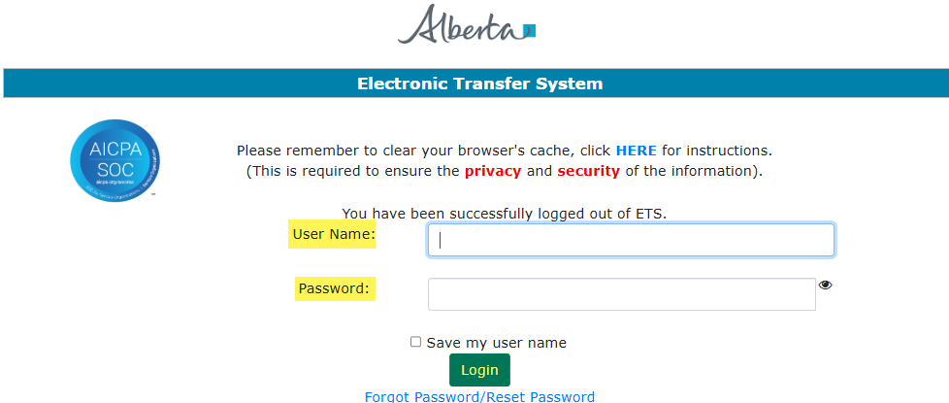
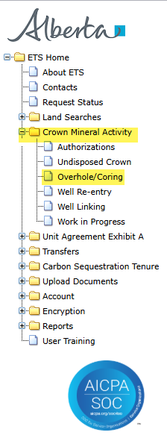
Carbon Sequestration - Crown Mineral Activity
Government of Alberta
LOGIN TO ETS
1. Login to ETS with your user name and password
2. Expand Crown Mineral Activity
Overhole/Coring form
Use this form to submit request on Sequestration Overhole OR Sequestration Corehole.
3. Overhole/Coring
Page 4

Slide 5

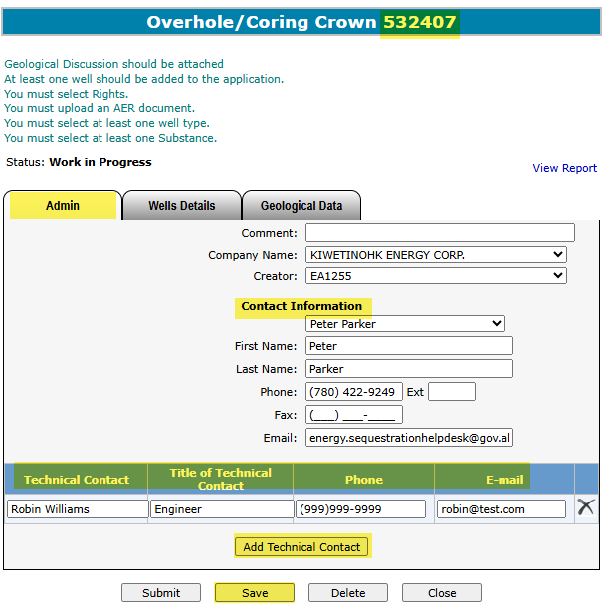
Carbon Sequestration - Crown Mineral Activity
Government of Alberta
ADMIN TAB
This tab is required for all requests.
The Company Name and Creator is autopopulated based on the login information of the creator.
1. Add the Contact Information either by selecting from the dropdown list or entering it manually.
To delete a contact entry, click the X.
3. Click Save. ETS request number is generated at the header.
2. Click Add Technical Contact. Input the Technical Contact info on the grid.
Page 5

Slide 6
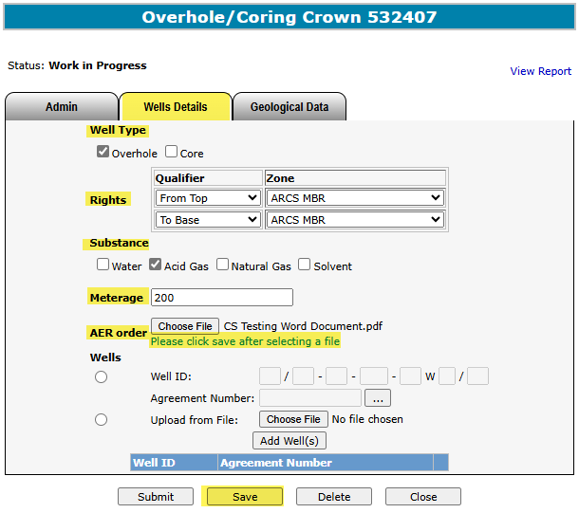
Carbon Sequestration - Crown Mineral Activity
Government of Alberta
WELLS DETAILS TAB - WELL TYPE, RIGHTS, SUBSTANCE, METERAGE and AER ORDER
(SEQUESTRATION OVERHOLE or COREHOLE)
1. Well Type. Checkmark that applies.
2. Rights. Input by using the dropdown selection.
3. Substance. Checkmark that apply
4. Meterage. Enter the meterage.
5. AER order. Click Choose File
6. Click Save
Page 6

Slide 7
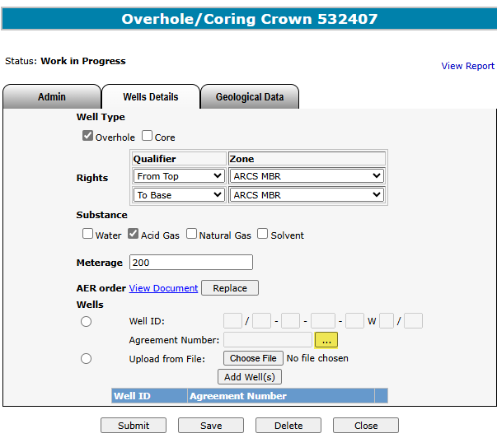
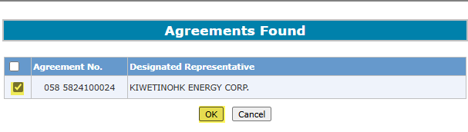
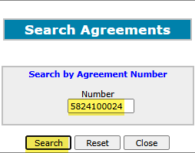
Carbon Sequestration - Crown Mineral Activity
Government of Alberta
WELLS DETAILS TAB – SEARCH and ADD CS AGREEMENT
(SEQUESTRATION OVERHOLE or COREHOLE)
4. Checkmark the agreement
5. Click OK
1. Add CS Agreement. Click the (…)
2. Enter the CS Agreement number
3. Click Search
Page 7

Slide 8
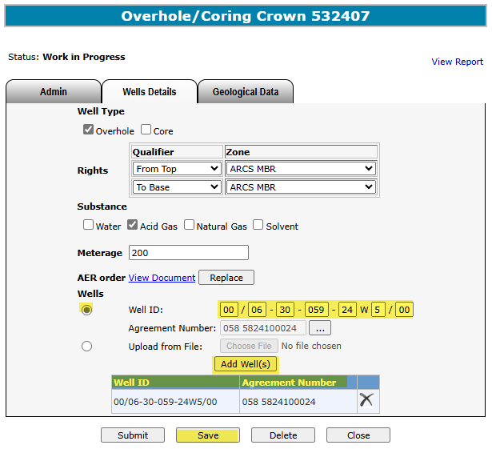
Carbon Sequestration - Crown Mineral Activity
Government of Alberta
WELLS DETAILS TAB – ADD WELL(S)
(SEQUESTRATION OVERHOLE or COREHOLE)
1. Click Well ID button
2. Enter the Well ID
4. Well is added on the well grid. If adding more than one wells, repeat steps 1 to 3.
3. Click Add Well(s)
5. Click Save
To delete a well, click the X.
Page 8

Slide 9
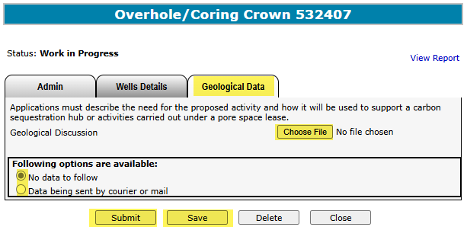

Carbon Sequestration - Crown Mineral Activity
Government of Alberta
GEOLOGICAL DATA TAB
2. Check the
appropriate box
1. Browse and upload document. Once document is uploaded, click Save.
4. Click Submit
3. Click Save
You may click on the View Report link to review the details of this CMA Application.
Delete – This deletes the entire application. The Status changes to Client Deleted.
Close – This closes the application form.
Page 9

Slide 10
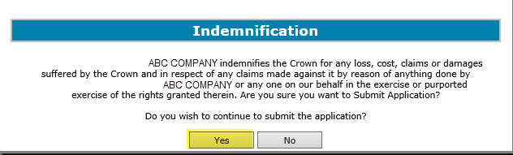
Crown Mineral Activity
Government of Alberta
INDEMNIFICATION
In order to continue to submit the application, click Yes on the Indemnification box.
Click Yes
Page 10

Slide 11
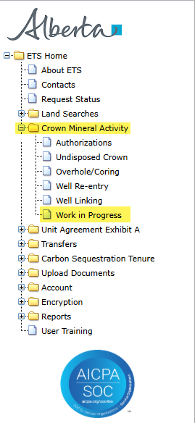
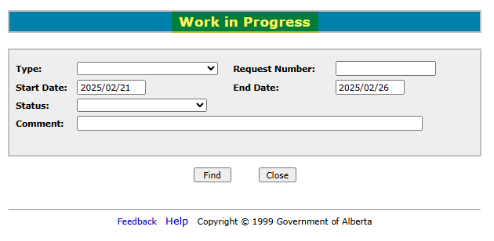
Carbon Sequestration - Crown Mineral Activity
Government of Alberta
WORK IN PROGRESS
The Work In Progress functionality of CMA enables you to retrieve a request/documents and view the request status.
Expand Crown Mineral Activity node and click Work in Progress subnode.
Page 11

Slide 12
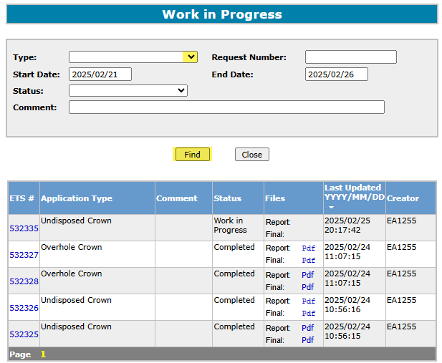

Carbon Sequestration - Crown Mineral Activity
Government of Alberta
WORK IN PROGRESS – RETRIEVE and VIEW REQUESTS
1. Retrieve Requests.
Choose the request Type.
Click the drop down arrow. Enter other request parameters to narrow your search, if needed.
2. Click Find. Search result is displayed in the grid below.
Select the Report: Pdf link to see the details of your request.
Click on the ETS request number link to view each request.
All parameters are searchable. The Start and End dates default depending on the range of days chosen in your Account Preferences. To see all available requests remove the Start Date.
Page 12

Slide 13
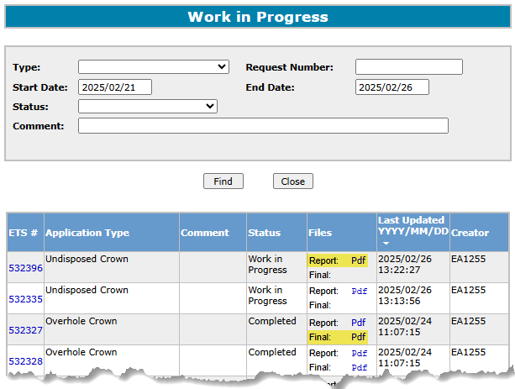
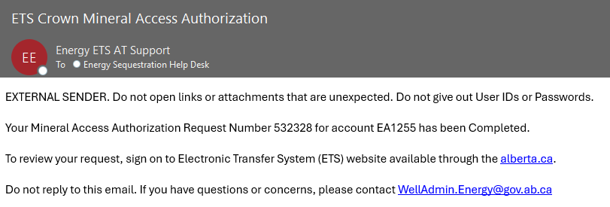
Carbon Sequestration - Crown Mineral Activity
Government of Alberta
WORK IN PROGRESS – SEARCH RESULTS and EMAIL NOTIFICATION
The information on the screen can be re-sorted by clicking on the column headers.
For each request, there will be two PDF documents available in the Files column: Report and Final.
Report Pdf is the application summary report
Final Pdf is the Final letter in .PDF format uploaded from the department.
The request will remain at Processing until the Final Letter has been received from the department. Then, the Status changes to Complete.
When Final letter is uploaded, an email notification is sent to the client stating that the request has been completed.
Login to ETS/CS Tenure Sequestration/Work in Progress.
Enter the quoted Request Number from the email notification under the Request Number field.
Page 13

Slide 14

Carbon Sequestration - Crown Mineral Activity
Government of Alberta
Congratulations!
You have completed the
CS CMA –
Overhole / Corehole
Online Training Course
If you have any comments or questions on this training course,
please forward them to:
energy.Sequestrationhelpdesk@gov.ab.ca
Page 14

