Slide 1
Welcome
Welcome!
E-Bidding is mandatory for the submission of bids for Petroleum and Natural Gas (PNG) leases and licences and for Oil Sands (OS) permits and leases. Bid requests must be submitted using Alberta Energy's Electronic Transfer System (ETS).
The Bidding training modules have been developed to teach you how to create and submit a bid for parcels posted in the Alberta Energy PNG and OS Public Offerings.
To the ETS – Bidding Overview
Online Training Course

Slide 2
Revisions
Date | Revisions Type | Page Number
August 31, 2012 | Conversion | All
April 2020 | Updated | All
December 2020 | Update the ETS login page | various

Slide 3

Introduction
In this module, you will learn about:
Overview of Bidding
Bidding Lifecycle
Bidding Roles
Account Preferences
Bid Request Preferences
We recommend that you view the common training module before proceeding to the other Bidding training modules:
ETS Account Setup and Preferences (For Site Administrators)

Slide 4

Overview of Bidding
Creating bid requests can be done by using the Bid Request screen or, by using a map interface screen to select your parcels.
Bidding Rules are published on the inside cover of each Public Offering Notice and can be viewed at:
https://content.energy.alberta.ca/Tenure/1314.asp
You should be familiar with these rules before beginning the bid process.

Slide 5
Bidding Lifecycle

Slide 6
Roles
An individual within the company can access the Bidding functionality in ETS if he/she has a Client Account created and is assigned a Bidding Role by the company's Site Administrator. These are the roles for Bidding:
Coordinator - The client can see all Bid Requests within their company and re-assign requests as necessary unless limited by a certain group assigned by the Site Administrator.
Creator - The client can create Bid Requests in the system.
Submitter - The client can submit Bid Requests to the Department.
Viewer - The client can only view Bid Requests that have been assigned to him/her.
Please review course: ETS Account Setup and Preferences (For Site Administrators)

Slide 7
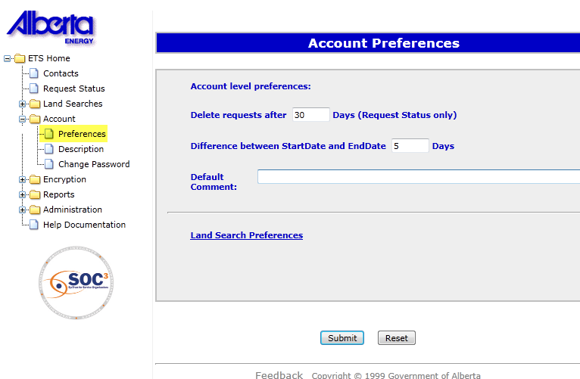

Account Preferences
Delete requests after X Days allows you to set the number of days (maximum 90 days) that your requests will remain on ETS before Alberta Energy deletes them.
Difference between Start Date and End Date X Days allows you to set the range of days (maximum 90 days) you can see results displayed on the Request Status screen and the Work in Progress screen.
Default Comment allows you to enter text that will be displayed in the comment box in the Bid Request screen. This comment will assist you in identifying the request.
Tip: If you remove the Start Date from the Request Status or Work in Progress screen you will see all the available information on the screen.

Slide 8
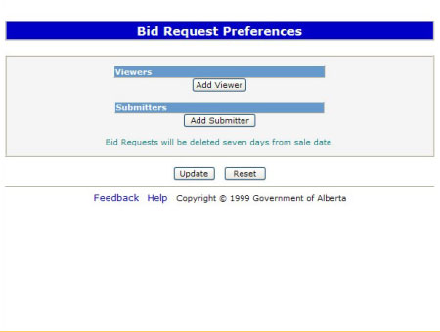
Bid Request Preferences
More Information (Page 9 to 13)
Under Viewers, you can select users to view your bid requests. You can add as many viewers as you want by using the Add Viewer button and selecting their account name from the drop down list.
Under Submitters, you can select users to submit your bid requests. If you have a creator/submitter role, adding yourself in this screen by selecting your account name from the drop down list will allow you to submit each bid request you create. If you do not do this, you will need to select a submitter every time you create a bid request.

Slide 9
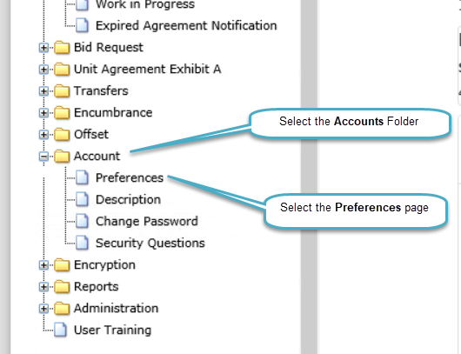
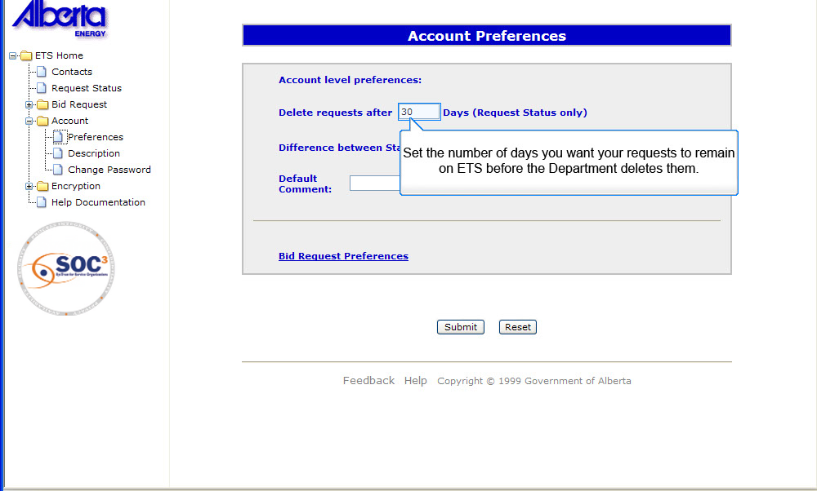
BRP 1
Clicking on preferences link opens up account preferences page
Back to Bid Request Preferences

Slide 10
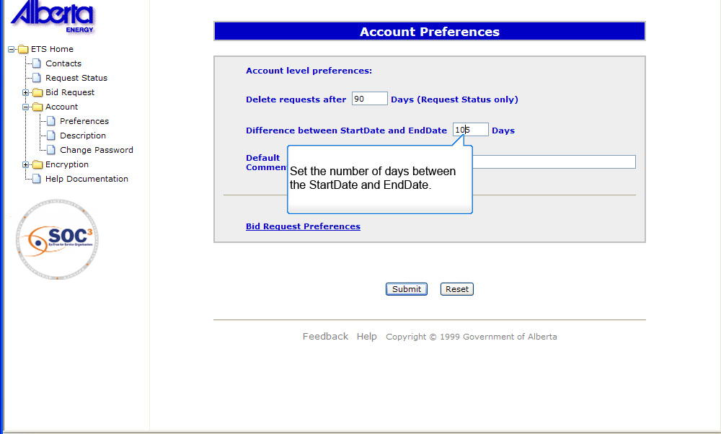
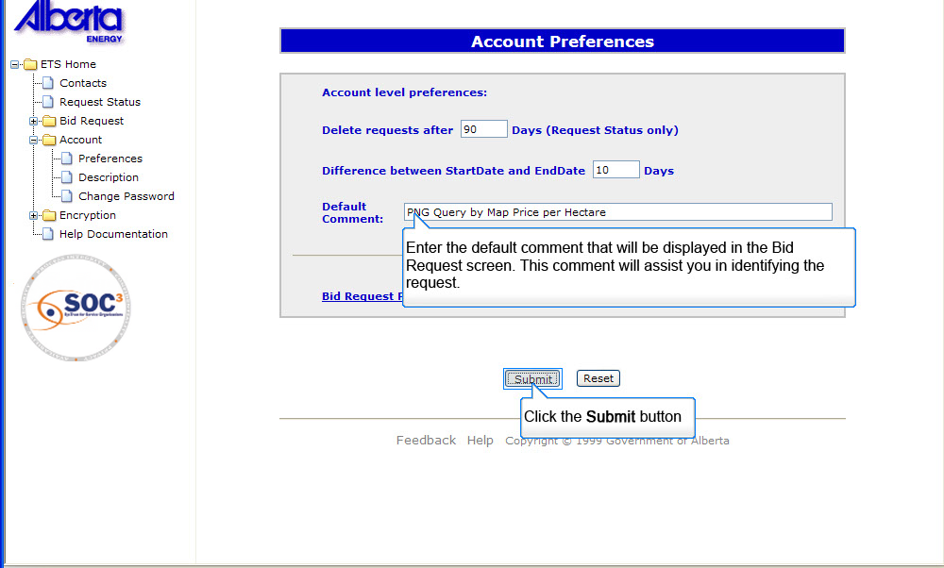
BRP 2
You can make changes to number of days before a request is deleted, number of days between start date and end date and default comments
Back to Bid Request Preferences

Slide 11
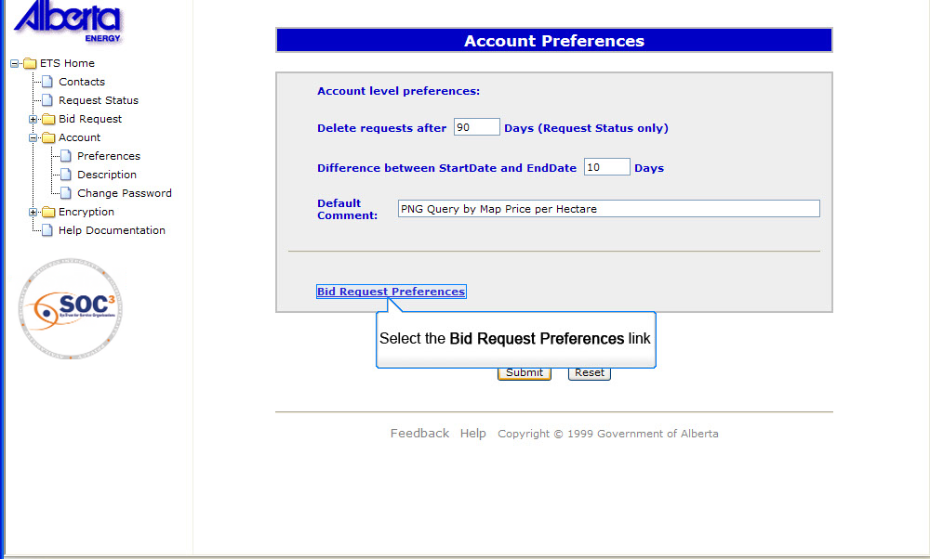
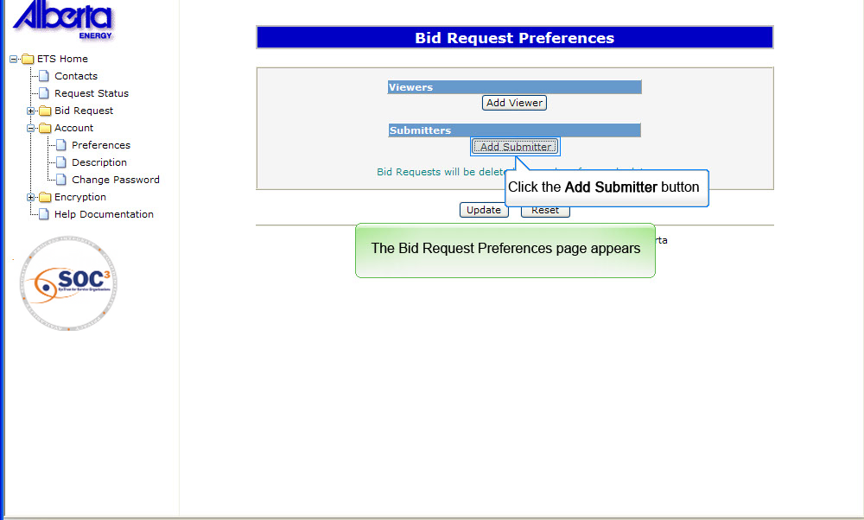
BRP 3
Clicking on the Bid Request Preferences link opens up the Bid Request Preference page
Back to Bid Request Preferences

Slide 12
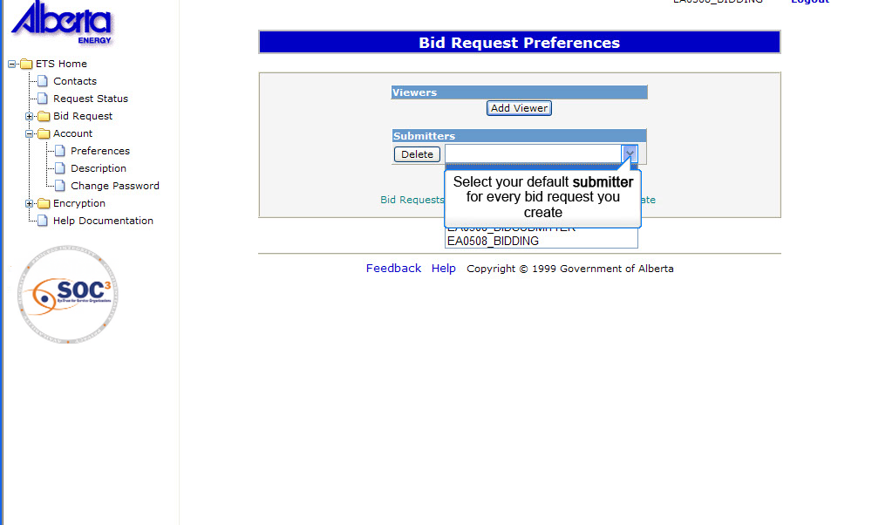
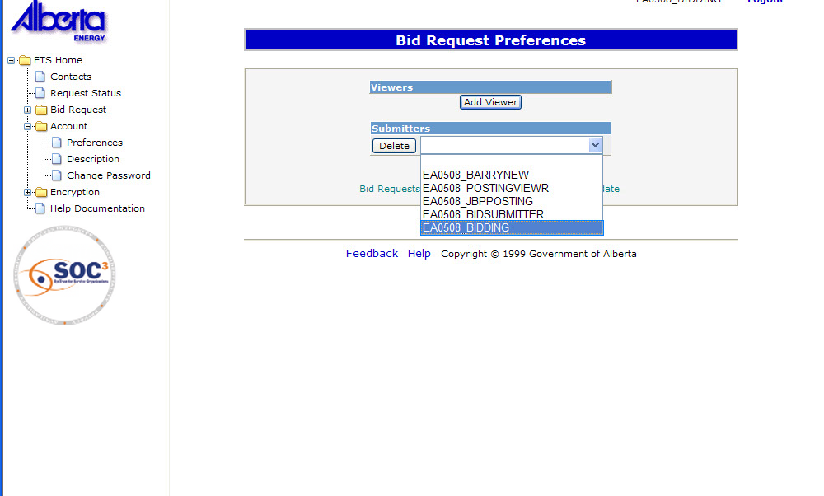
BRP 4
Select submitter from the dropdown list
Back to Bid Request Preferences

Slide 13
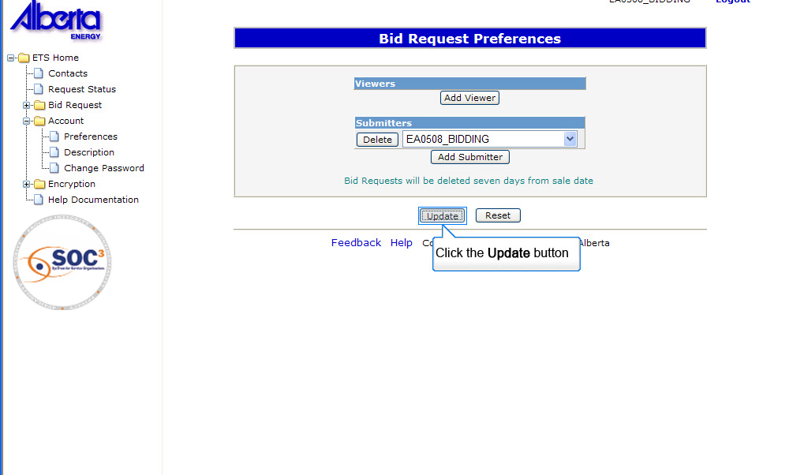
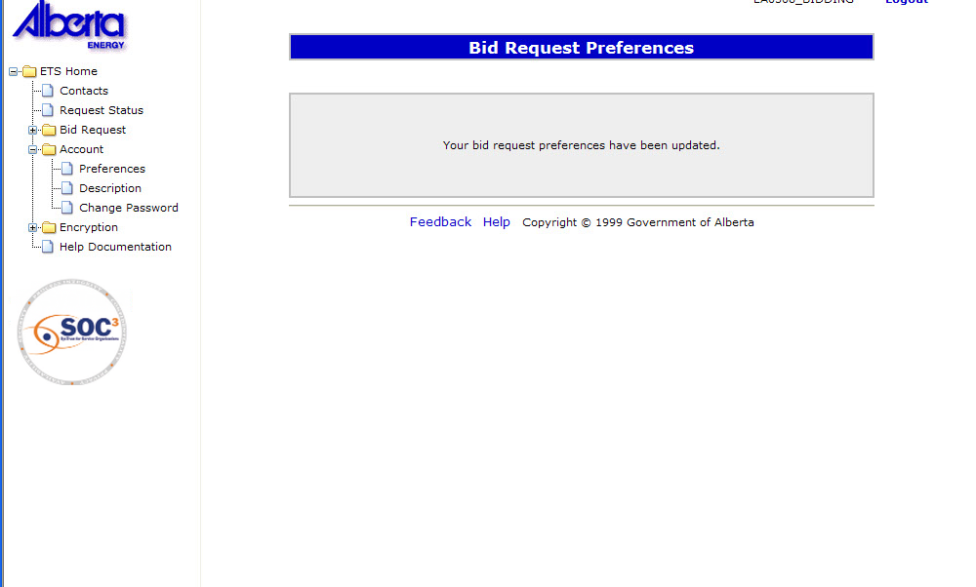
BRP 5
Click update button after selecting submitter A confirmation screen will display
Back to Bid Request Preferences

Slide 14
Resources
ETS Support and Online Learning provides access to relevant guides, course and other information
If you have questions, please contact
for PNG: Bidding.Energy@gov.ab.ca or the Sales Helpdesk at (780)644-2300 or
for Oil Sands: OSTenure@gov.ab.ca

Slide 15

Conclusion
Congratulations!
You have completed the ETS – Bidding Overview
Online Training Course
Please proceed to the subsequent modules detailing other functionality of the Bidding application.
If you have any comments or questions on this training module, please forward them to the following email address:
Bidding.Energy@gov.ab.ca

