Slide 1
Assignment of Agreement Application
Government of Alberta
Welcome!
To the
Assignment of Agreement Application
Online Training Course
In this module you will learn how to:
Create an Assignment of Agreement application
Concur ETS request
Retrieve and view agreement documents.

Slide 2
Assignment of Agreement Application
Government of Alberta
Revisions Table
Date | Revisions Type | Page Number
February 3, 2025 | Initial Creation | All

Slide 3
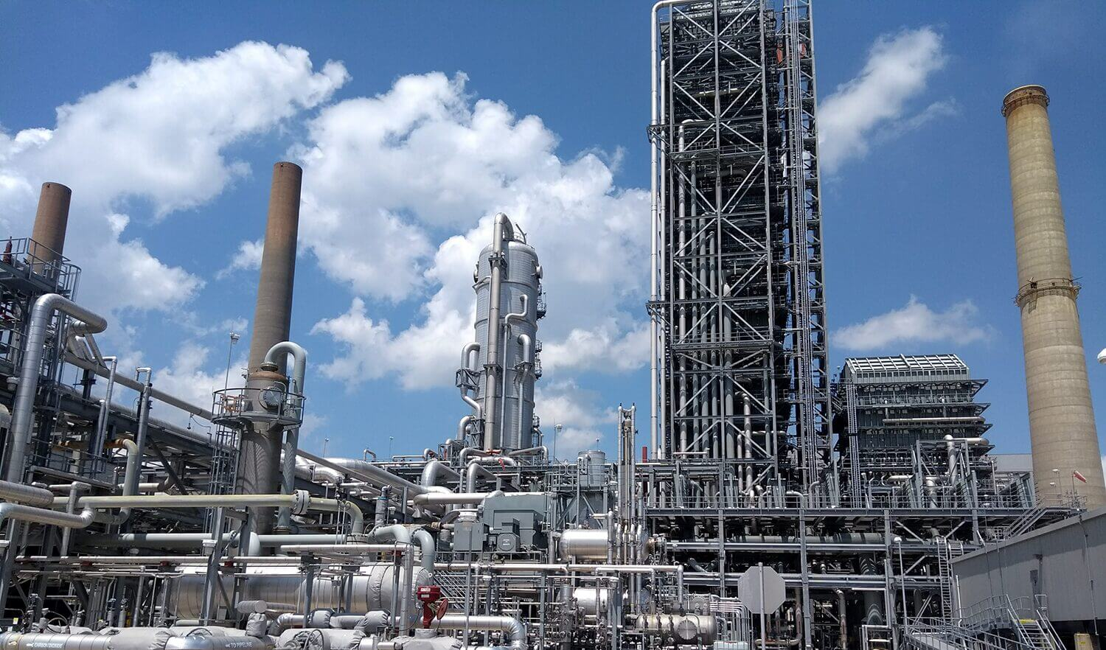
Assignment of Agreement Application
Government of Alberta
INTRODUCTION
The Assignment of Agreement application form allows client to apply to replace a current agreement holder of an existing Carbon Sequestration Evaluation Agreement (058) or Carbon Sequestration Agreement (059) with a new agreement holder in Electronic Transfer System (ETS).

Slide 4
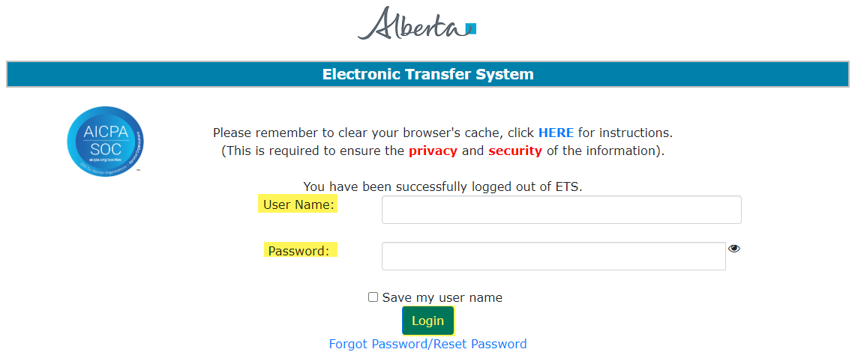
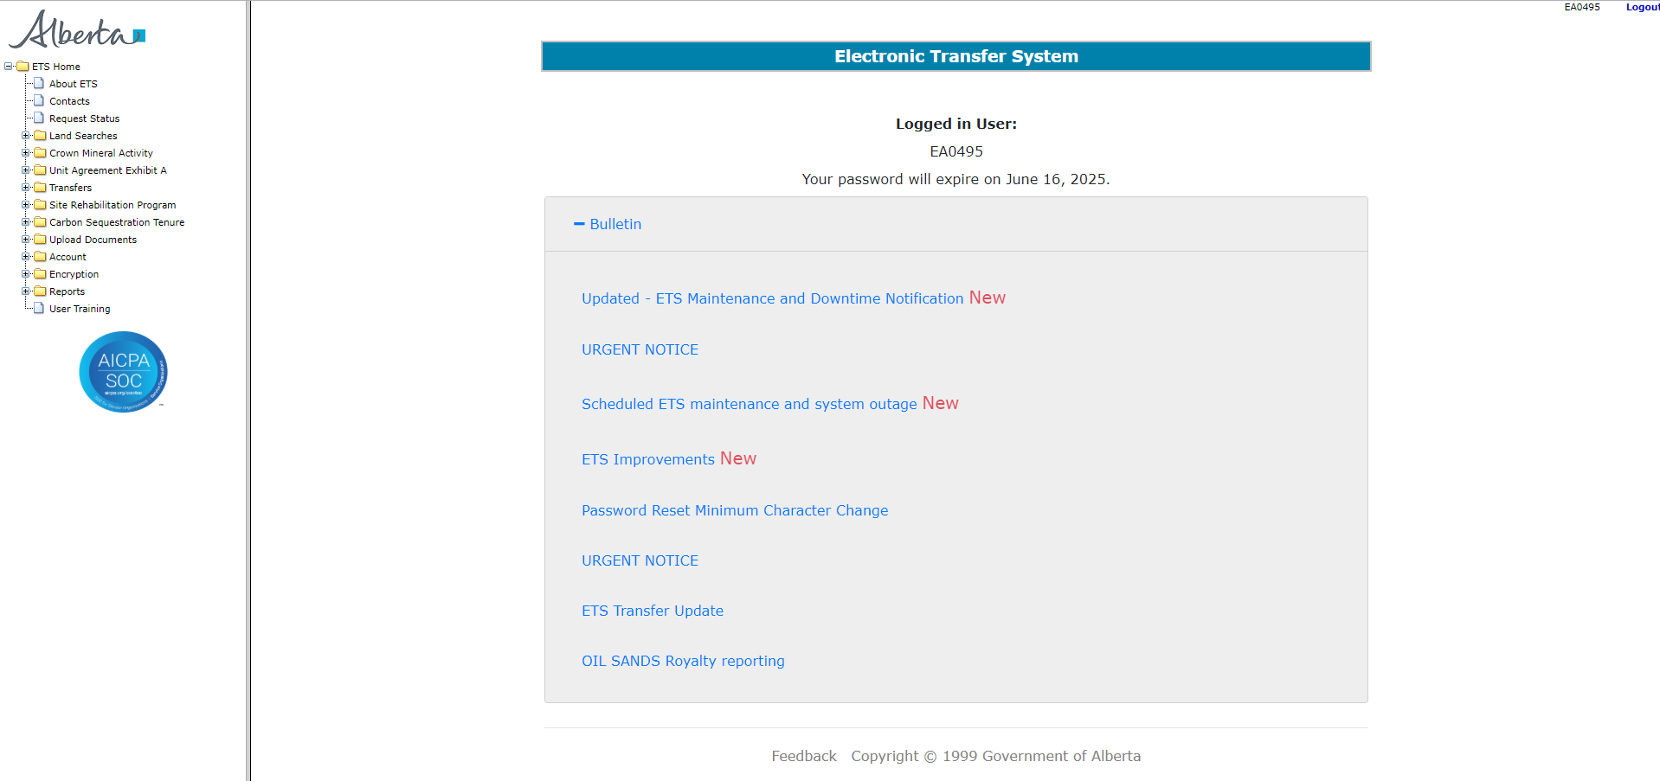
Assignment of Agreement Application
Government of Alberta
LOGIN TO ETS
Go to ETS (https://ets.energy.gov.ab.ca/logon.aspx)
Enter your login credentials: User Name (EN account) and Password.
Once logged in, the screen below is displayed.

Slide 5
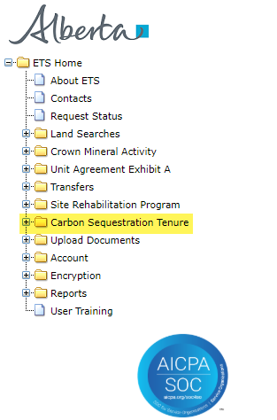
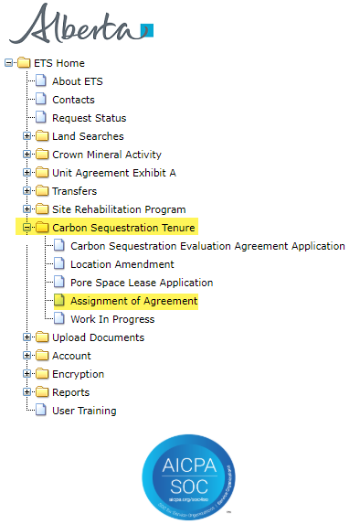
Assignment of Agreement Application
Government of Alberta
NAVIGATION TO ASSIGNMENT OF AGREEMENT APPLICATION
In the treenode (left-hand side of the screen), navigate to Carbon Sequestration Tenure node.
Expand Carbon Sequestration Tenure node to display its subnodes.
Click Assignment of Agreement subnode.
2.
3.
1.

Slide 6
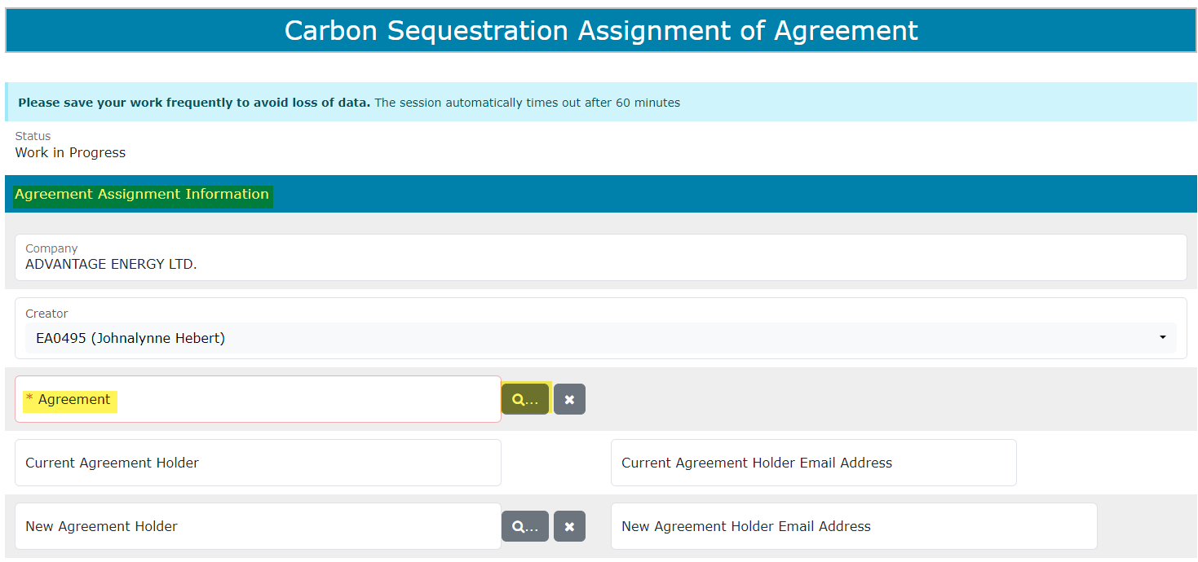
Assignment of Agreement Application
Government of Alberta
AGREEMENT ASSIGNMENT INFORMATION SECTION
On the main screen, a blank application form is displayed. ETS auto populates the Company and Creator fields. These information are generated from the login account information.
Mandatory fields are outlined in red and flagged with asterisk (*).
Click the magnifying glass to search agreement.

Slide 7
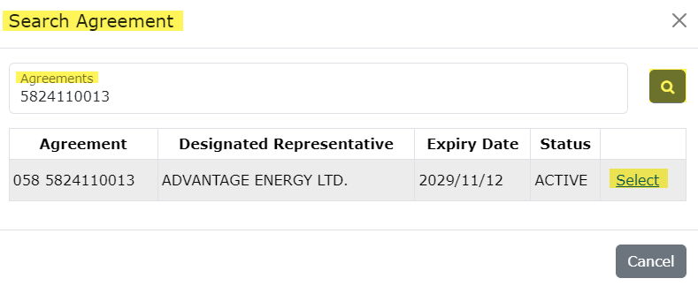
Assignment of Agreement Application
Government of Alberta
INFORMATION SECTION – ADD AGREEMENT
In the Search Agreement box,
Click the Agreements field and type in a carbon sequestration related agreement number.
Select the magnifying glass to search the agreement.
Search result appears and displays the Designated Representative, Expiry Date and Status. If the information is correct, click Select.
Click Cancel if you need to restart the search.
2.
1.
3.

Slide 8
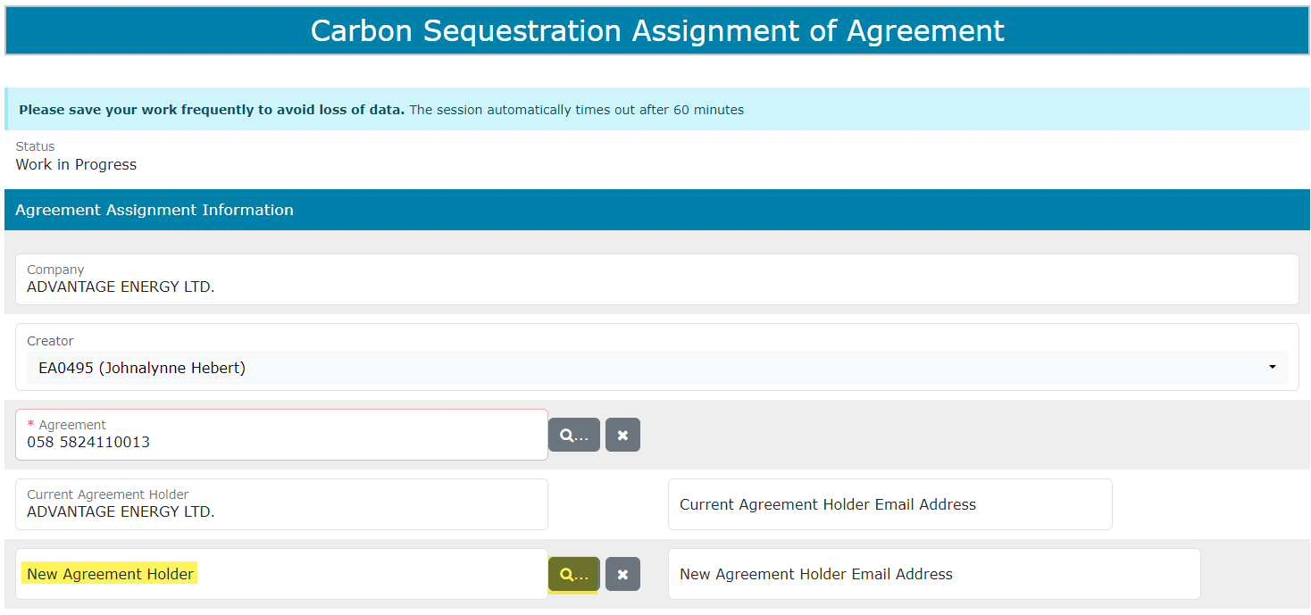
Assignment of Agreement Application
Government of Alberta
INFORMATION SECTION – ADD NEW AGREEMENT HOLDER
The agreement number is now added in the application.
The Current Agreement Holder is populated based on the agreement number added.
The Email Address fields are optional.
Click the magnifying glass to search a client.
Click the magnifying glass to search agreement.

Slide 9
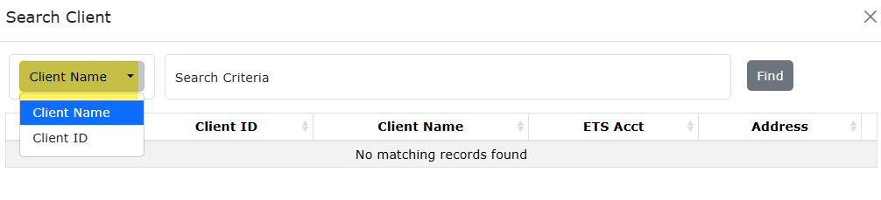
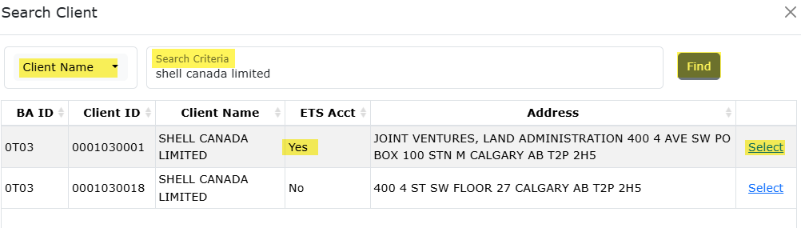
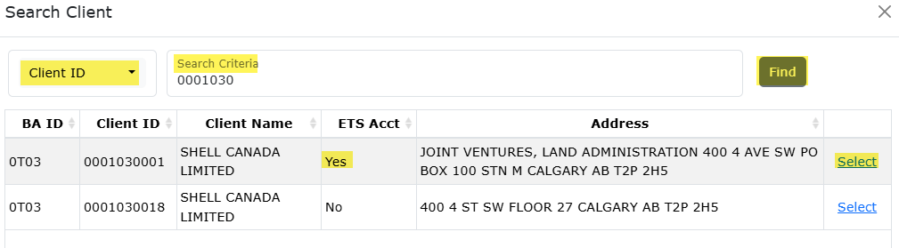
Assignment of Agreement Application
Government of Alberta
INFORMATION SECTION – NEW AGREEMENT HOLDER - SEARCH CLIENT
The client can be searched by either the Client Name or the Client Number.
1.
By default, Client Name search criteria displayed by default. Click the dropdown to select the desired search criteria.
Depending on the search criteria chosen, enter the Client Name OR the Client ID in the corresponding field.
Click Find.
  Search result appears and displays the Business Associate ID, Client ID, Client Name, ETS Acct Yes/No, Address.
Click Select to add the client on the form. Selected client must have an active ETS Acct. This will be required to concur the assignment.
2.
3.
4.

Slide 10
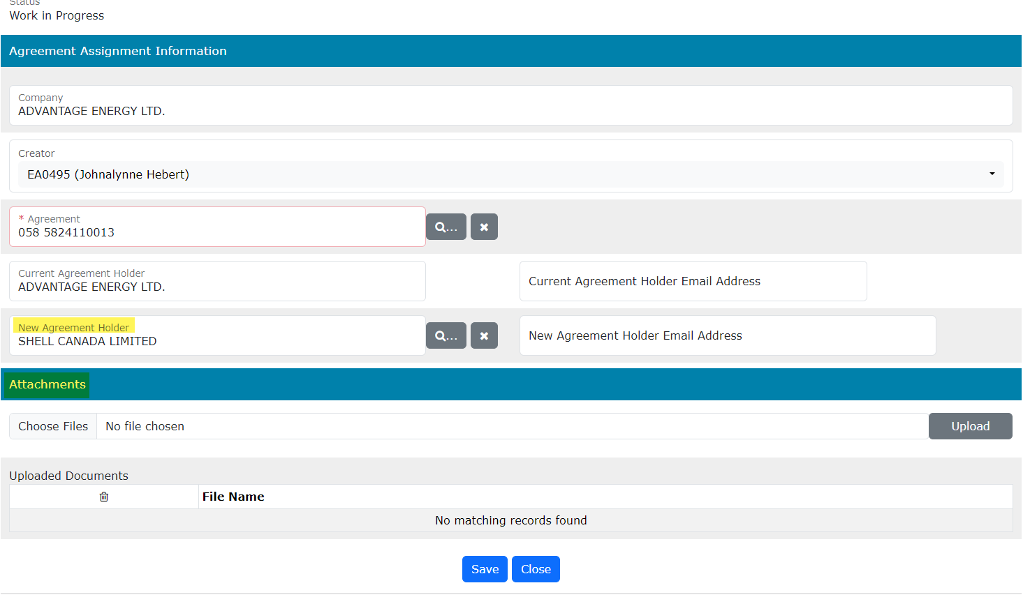
Assignment of Agreement Application
Government of Alberta
INFORMATION SECTION – NEW AGREEMENT HOLDER ADDED
From previous slide, New Agreement Holder is now added.

Slide 11
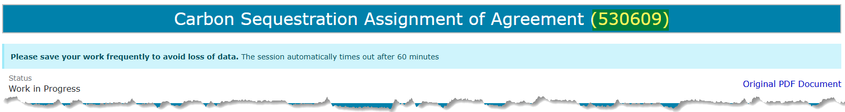
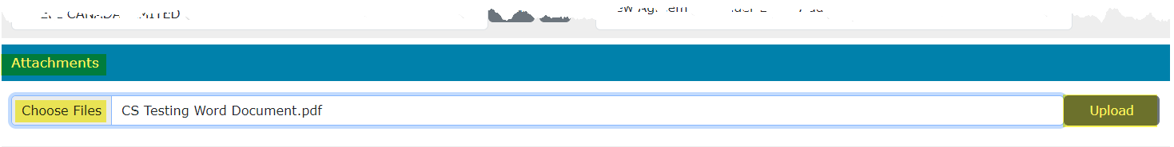
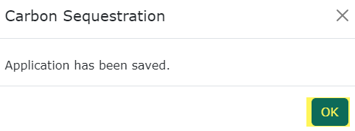
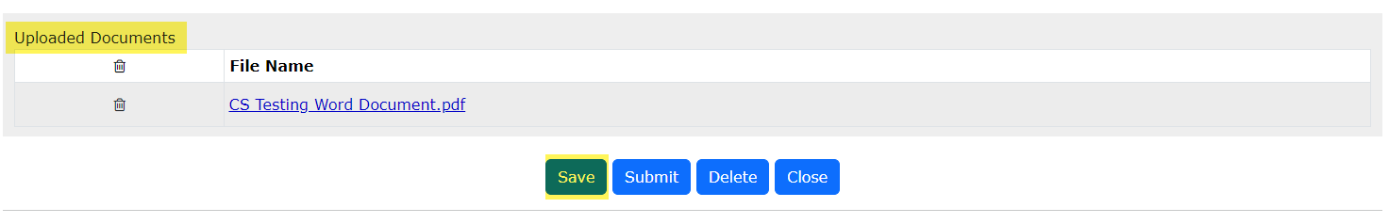
Assignment of Agreement Application
Government of Alberta
ATTACHMENTS
Click Choose Files. File Explorer folders opens. Locate the file to upload. Note: up for 5 supplementary documents can be uploaded.​
Back to the ETS request application, the name of the file is added on the ‘No file chosen’ field.​
Click Upload. ​
Save prompt appears, click OK. The document is added in the Uploaded Documents grid.​
​
To delete an uploaded document, simply click the corresponding trash bin icon.​
To add, follow the steps above.
5. Assigned ETS request number.
1.
2.
4.
3.
5. Click Save (1st save, which generate the ETS request number.

Slide 12
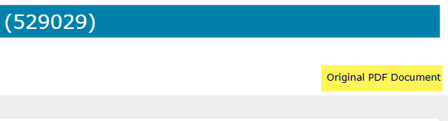
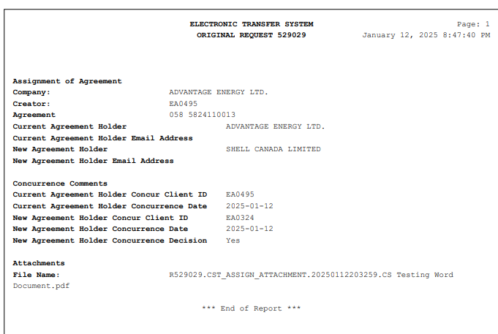
Assignment of Agreement Application
Government of Alberta
APPLICATION SUMMARY REPORT
The Original PDF Document link is the application summary report. It contains all data entered on the application.
This tool is useful to review the entire application before submitting the application.
Click Original PDF Document located at the top right of the form to generate the report.

Slide 13
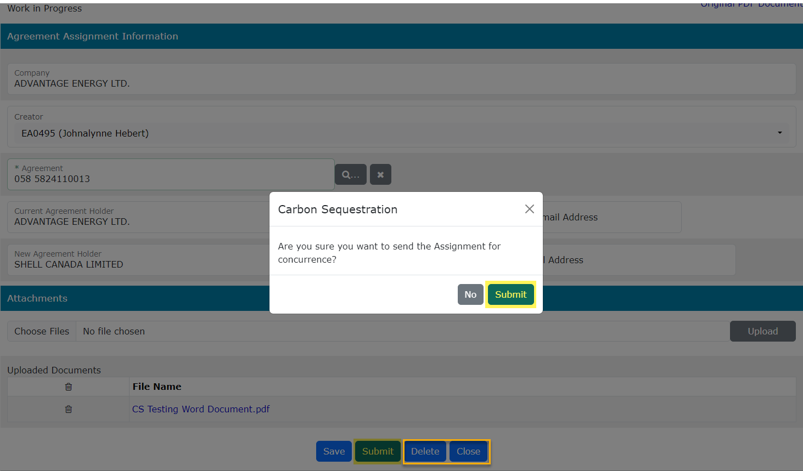
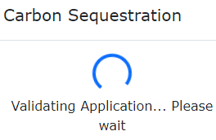
Assignment of Agreement Application
Government of Alberta
SUBMIT APPLICATION
Once all pertinent information has been entered, submit the Assignment of Agreement Application.
The system performs validation check to ensure all mandatory data has been provided.
Upon successful submission, the status is updated to Concur.
3. Click OK
2. Click Submit
1. Click Submit
Delete (deletes entire application) is available when the request Status is at Work in Progress.
Close (closes application).

Slide 14
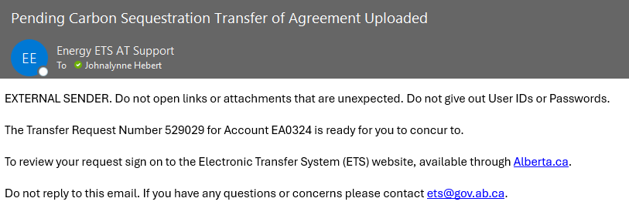
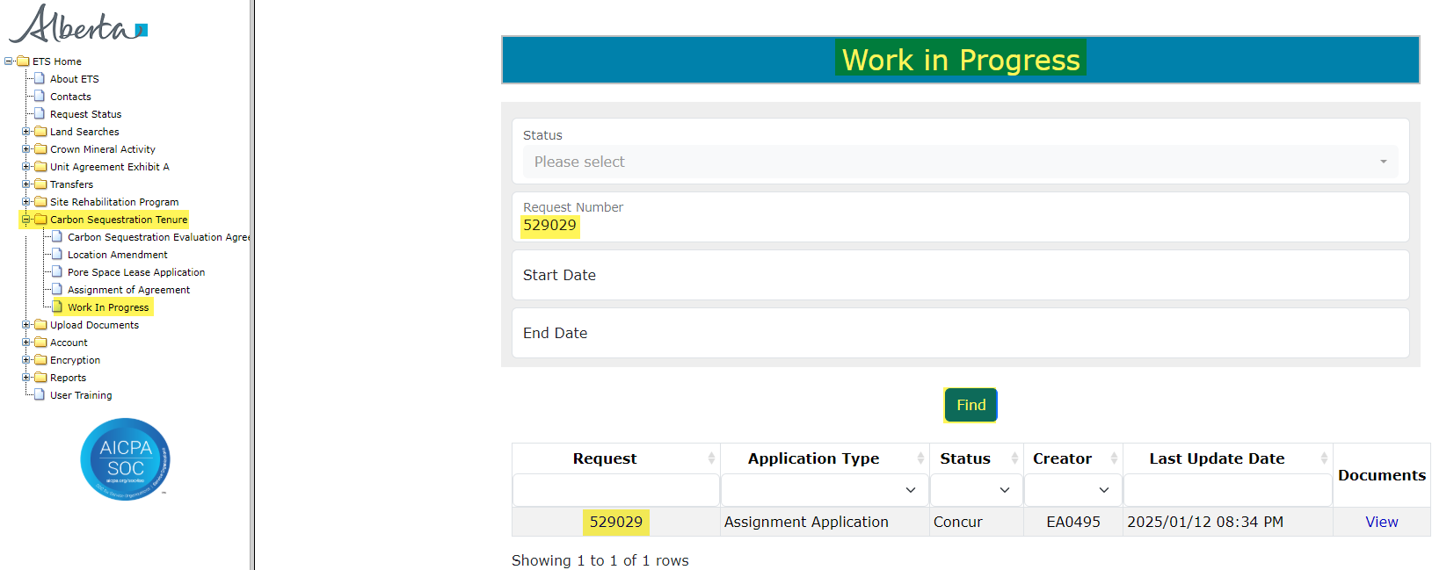
Assignment of Agreement Application
Government of Alberta
CONCURRENCE
The concurrer receives an email notification requesting to login to ETS to concur a specific request. If the creator of the request is the New Agreement Holder, then the Current Agreement Holder will concur and vice versa.
Login to ETS as the concurrer.
2. Enter the Request Number quoted from the email notification.
4. Click the Request number to open the application.
3. Click Find.
1. Navigate to Carbon Sequestration Tenure/Work in Progress

Slide 15
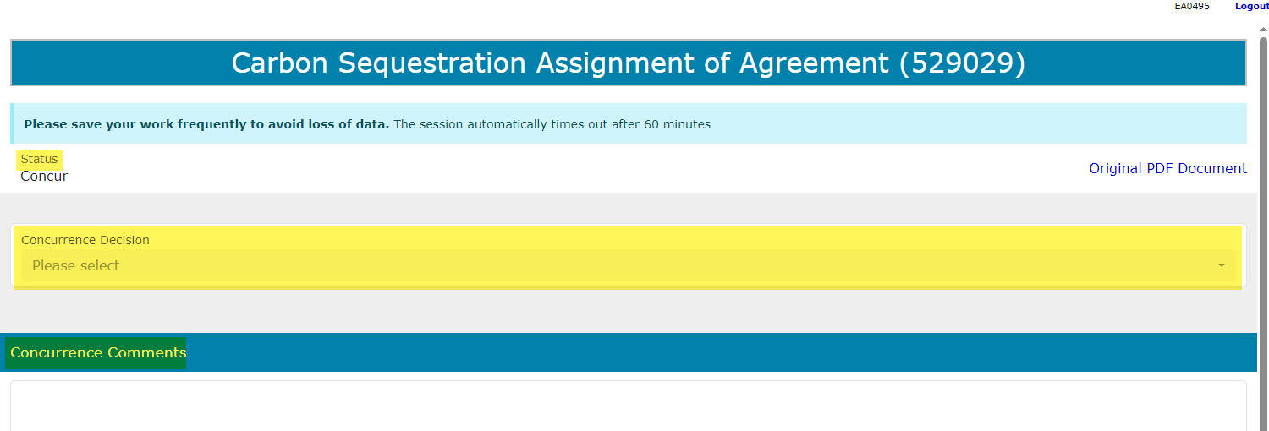
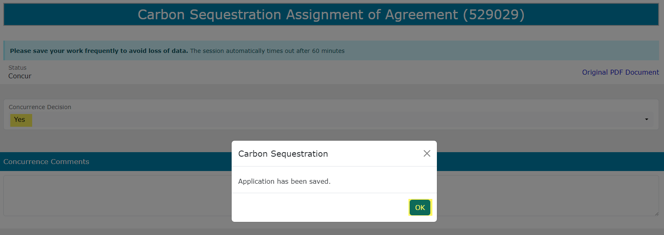
Assignment of Agreement Application
Government of Alberta
CONCURRENCE
1. Add Concurrence Decision. Select from the dropdown either Accept or Reject
2. If the concurrence decision is Reject, add the reason here under Comments.
3. Click Save.

Slide 16
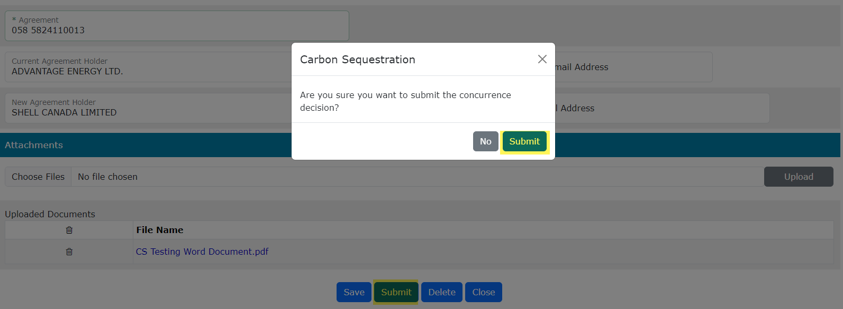
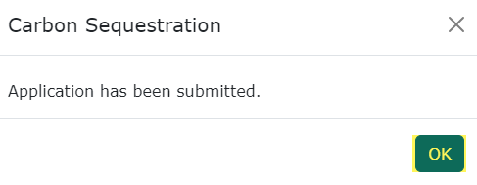
Assignment of Agreement Application
Government of Alberta
SUBMIT CONCURRENCE DECISION
2. Click Submit.
3. Click OK.
1. Click Submit.
When the concurrer submits the concurrence decision, this will submit the application.
If the concurrence decision is No, the application is rejected and the creator is notified via email notification.

Slide 17
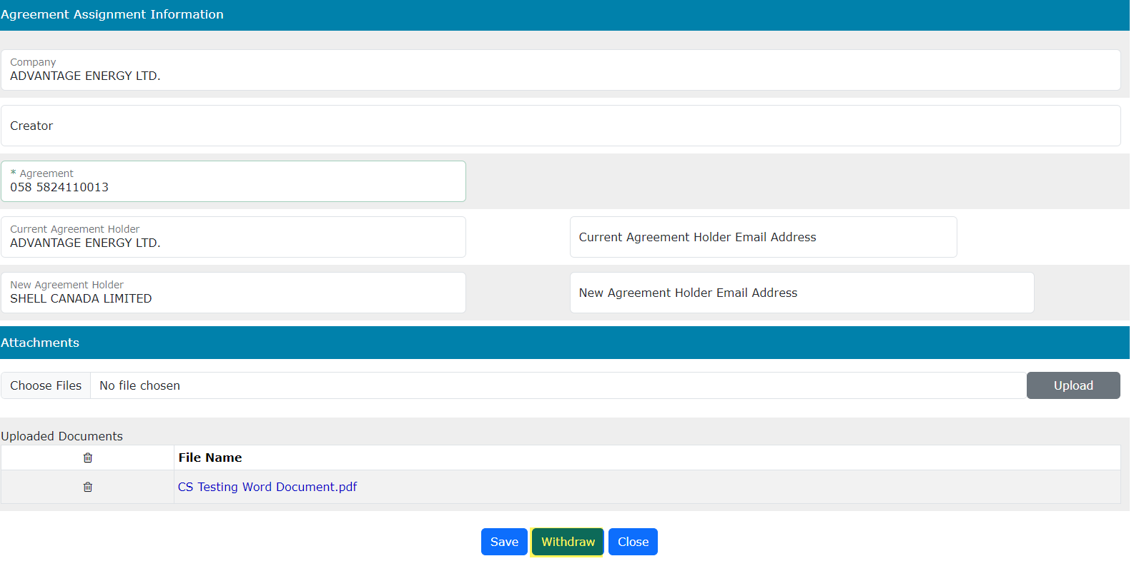
Assignment of Agreement Application
Government of Alberta
WITHDRAW APPLICATION
The Withdraw button is only available when the Status is Submitted.
The creator, submitter or concurrer has the option to withdraw the application during the duration of the status Submitted.
When the request status is changed from Submitted to Processing, the Withdraw option is no longer available.

Slide 18
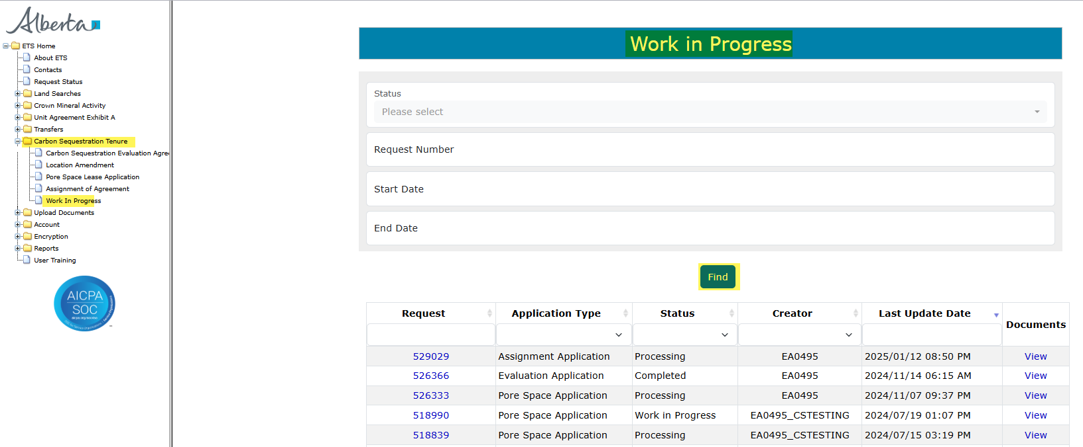
Assignment of Agreement Application
Government of Alberta
WORK IN PROGRESS
The Work in Progress screen contains all different status depending on the state of each ETS Request.
To search all ETS requests, select the Find icon on the Work in Progress screen.
User can also narrow the search by the following search parameters: Status, Request Number, Start Date and End Date.
Click the Request link to view the application.

Slide 19
Assignment of Agreement Application
Government of Alberta
WORK IN PROGRESS – continued…
Work in Progress
The creator can modify and save the form.
Submitted
The creator or submitter has Submitted the form.
Processing
The request has been submitted to Alberta Energy and Minerals. Only the contact information can be modified at this point. The rest of the application is read-only.
Completed
Application has been completed and agreements documents have been issued.
Client Withdrawn
Client has withdrawn the ETS application. This notifies Alberta Energy and Minerals they no longer want to proceed with the application.
Department Rejected
Alberta Energy and Minerals has rejected the client’s requested application.

Slide 20
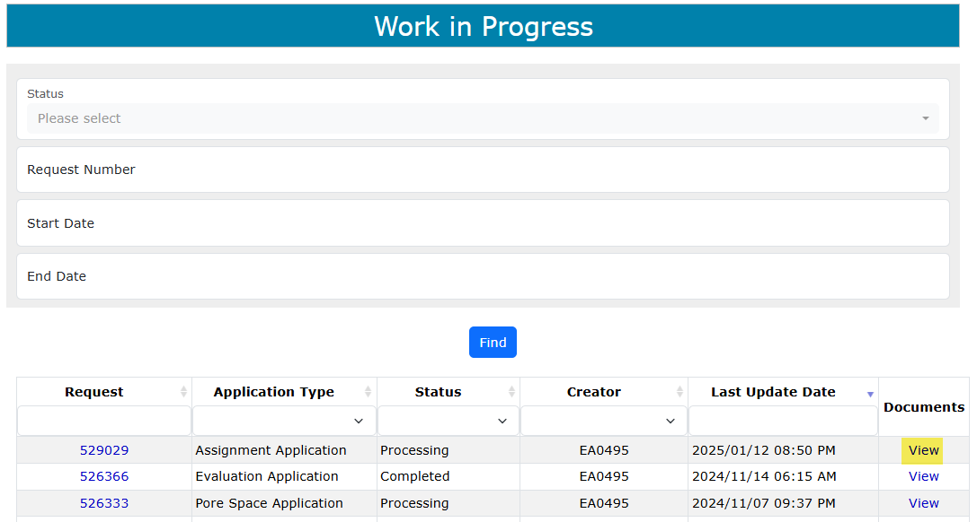
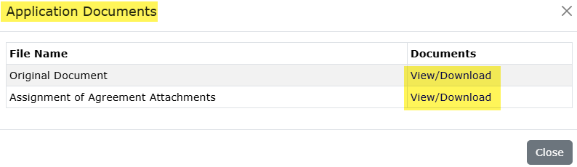
Assignment of Agreement Application
Government of Alberta
WORK IN PROGRESS – View Documents
User has the option to view all documents for the corresponding ETS request. The Application Documents box list all attached documents from the application.
2. Click View/Download
1. Click View

Slide 21

Assignment of Agreement Application
Government of Alberta
Congratulations!
You have completed the
Assignment of Agreement Application
Online Training Course
If you have any comments or questions on this training course,
please forward them to
energy.sequestrationhelpdesk@gov.ab.ca

