Slide 1
Welcome!
To the ETS – Agreement Management
Authorization
Online Training Course
Agreement Management – Authorization: This process involves authorizing a company to act on behalf of the designated representative for a Crown PNG agreement.

Slide 2
Revisions Table
Date | Revisions Type | Page Number
March 10, 2017 | Initial Creation | All
June 2020 | Update Banner and add Resource Page | All
October 2020 | Updated | Various
November 2022 | Updated | Added references to Geothermal Agreements

Slide 3
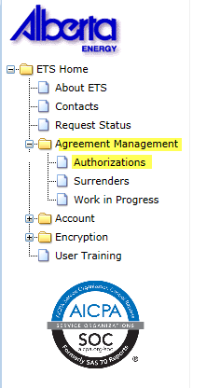

In this module you will learn how to:
As the company submitting the request for Authorization:
Complete a Agreement Management Authorization Request
Check the status of your request
As the company authorizing the request:
How to concur
How to reject
How to revoke
Course Pre-requisites:
Training System Overview
ETS Account Setup and Preferences (For Site Administrators)
You must have the Creator role to create or withdraw a request and the Submitter role to submit a request

Slide 4
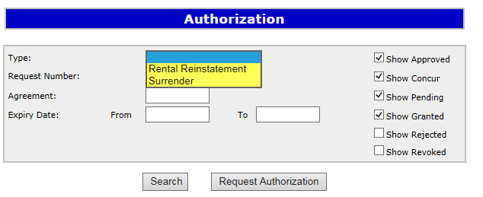

Authorization – Select Authorization Form Type
Type | Description
Rental Reinstatement | Use this form type for a PNG or Geothermal agreement, to authorize someone other than the Designated Representative on a Rental Reinstatement.
Surrender | Use this form type for a PNG or Geothermal agreement, to authorize someone other than the Designated Representative to Surrender an agreement.
Authorization for Rental Reinstatement and Surrender must be requested before a Rental Reinstatement or Surrender can be submitted.

Slide 5
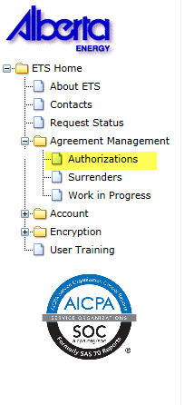
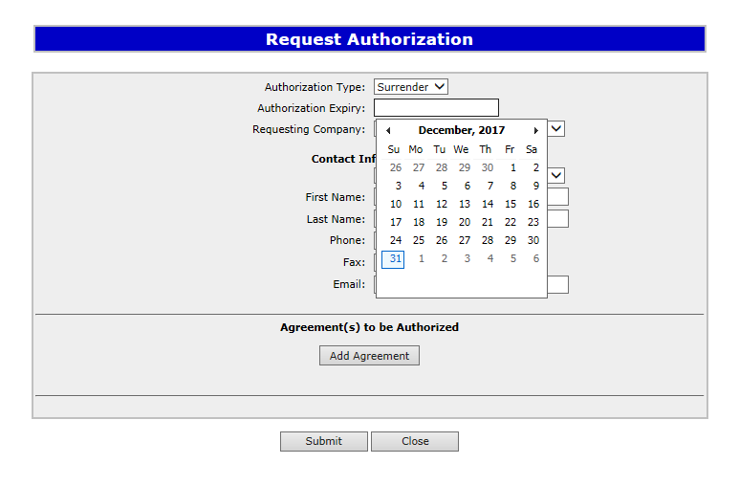

Create Authorization – Request Authorization
1. Expand
Agreement Management
Expand Agreement Management and Select Authorizations. The Request Authorization screen will populate. Select Surrender from the Authorization Type in the drop down box. You will then select an Authorization Expiry date from the drop down. Selection can be up to one year from the current date.
3. Select Authorization Type
4. Select Authorization Expiry
2. Select Authorizations
The authorization expiry date must be a future date, it cannot be a past date or the current date. The authorization expiry date is how long you will allow the authorization to be valid. It cannot be more than a year.

Slide 6
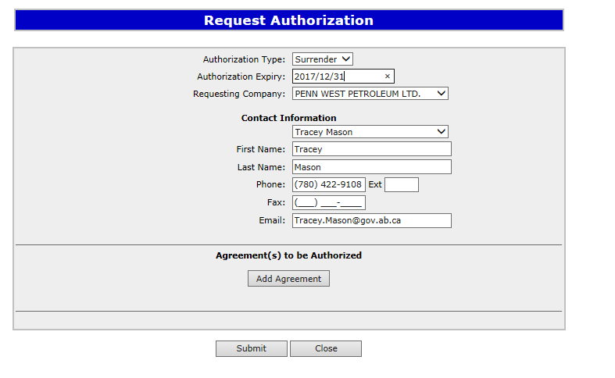
In the Requesting Company drop down box select the company requesting authorization from the Designated Representative. Then complete the Contact Information including phone number of the requesting company. If you do not include the phone number an error will occur. Select Add Agreement, this will populate Search Agreements.
1. Select Requesting Company
XYZ Company
2. Select Contact Information
3. Complete Phone Number
4. Select Add Agreement

Slide 7
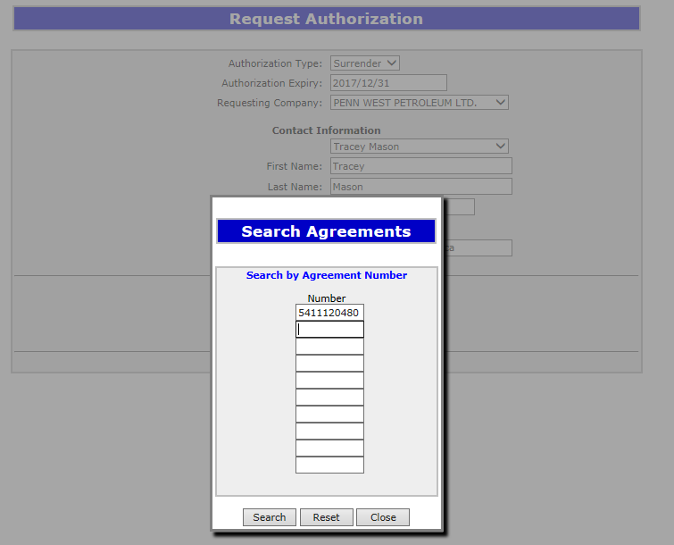
Enter the Agreement Number of the surrender you are requesting the authorization from the Designated Representative.
Enter
Agreement Number
001 1000
2. Select Search

Slide 8
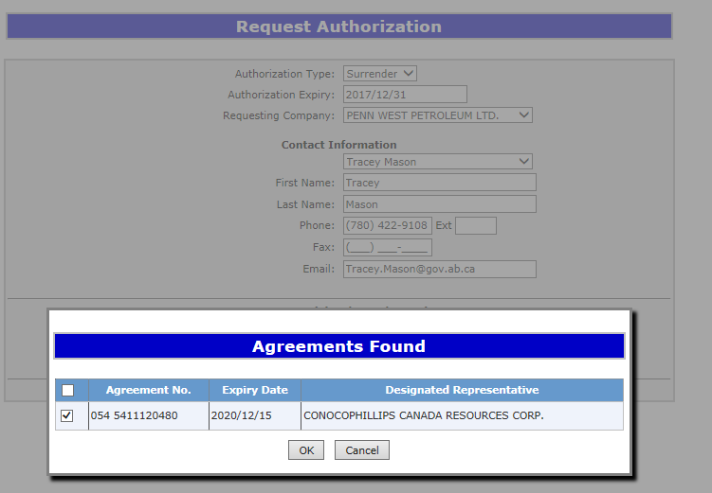
The Agreement will populate in the Agreements Found box. Confirm the agreement by placing a check mark in the confirmation box beside the Agreement Number and select Ok.
1. Place
Check Mark
001 1000
ABC Company
2. Select
Ok

Slide 9
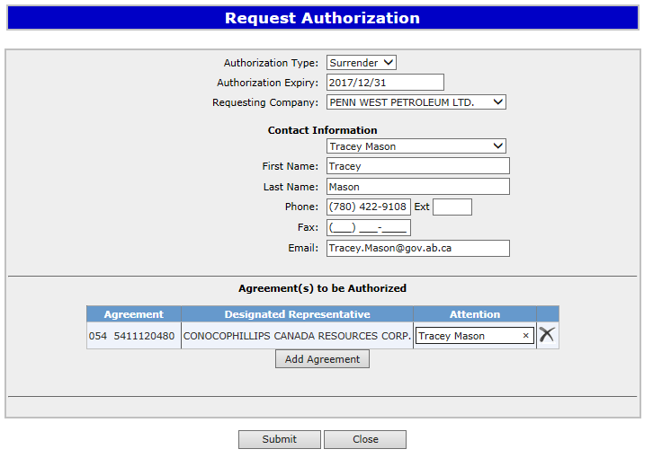
The agreement will now show at the bottom of the Request Authorization screen along with the Authorization Type, Requesting Company and Contact Information. Select submit.
XYZ Company
001 1000
ABC Company
Angel Best
Select
Submit

Slide 10

After submitting your Request Authorization and the information is submitted, a Request Number will populate. You can now Close the screen. You have successfully completed the Surrender Authorization.
Select
Close

Slide 11

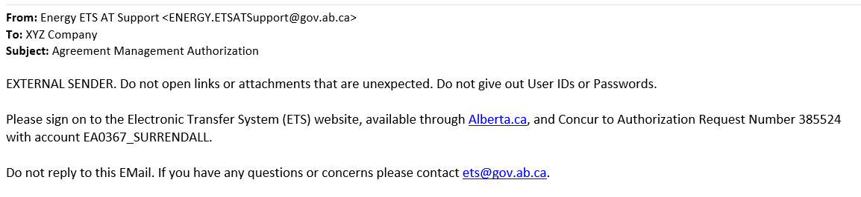
Once the Surrender Authorization has been submitted, the Designated Representative of the surrender agreement will receive notification to Concur the Surrender Authorization.

Slide 12
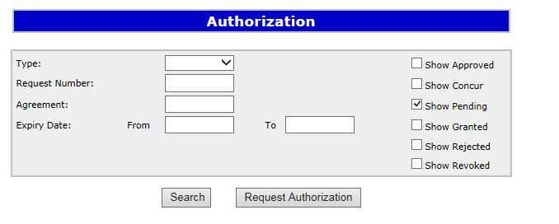
Authorization – Concur Authorization
The Concurring company will expand the Agreement Management node and select Authorizations. The Authorization screen will populate and select Show Pending, then Search.
3. Select Show Pending
1. Select Agreement Management
2. Select Authorizations
4. Select Search

Slide 13
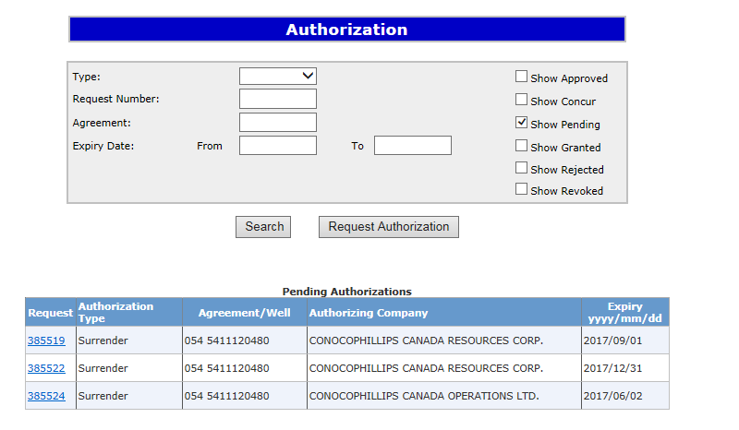
All Pending Surrender Authorizations will populate for the Concurring Designated Representative. Select the Request you want to Authorize.
1. Select
001 3000
ABC Company
001 2000
ABC Company
001 1000
ABC Company

Slide 14
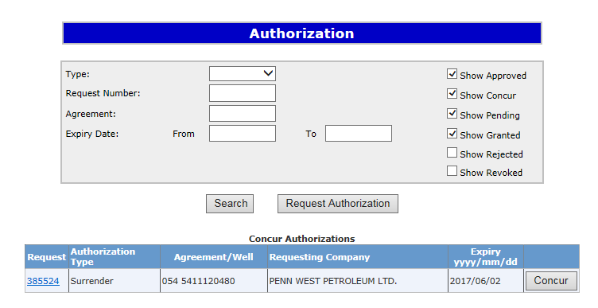
The Concur Authorizations will appear at the bottom of the Authorization screen. You will then select Concur
1. Select Concur
001 1000
ABC Company

Slide 15
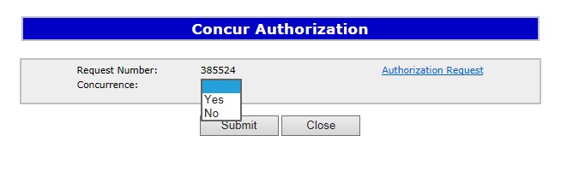
After you select Concur, the Concur Authorization screen will populate. Beside Concurrence, a drop down box will appear and you will select either Yes or No. After making your selection click on Submit.
1. Select either Yes or No
1. Select Submit

Slide 16
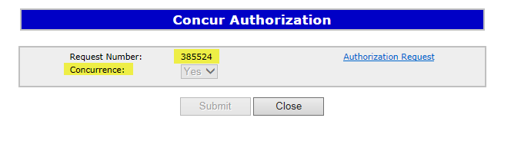

After you select submit, the Concur Authorization screen will populate indicating the Request Number and the Concurrence have been submitted. You can now Close the screen.
1. Select Close
The Request Authorization screen will appear confirming the Authorization has been submitted and the Request Number will populate. You can now Close the screen, this process has been completed.
1. Select Close

Slide 17
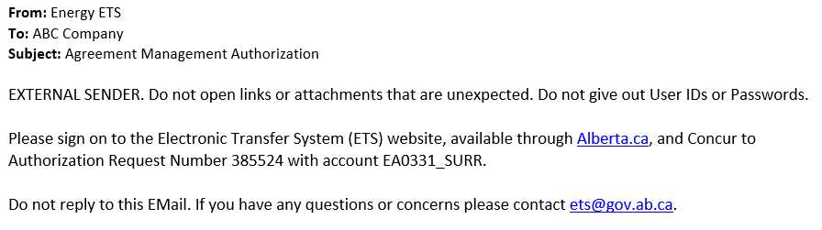
A notification will be sent to the Surrender Authorization requester to confirm the request has been completed.

Slide 18
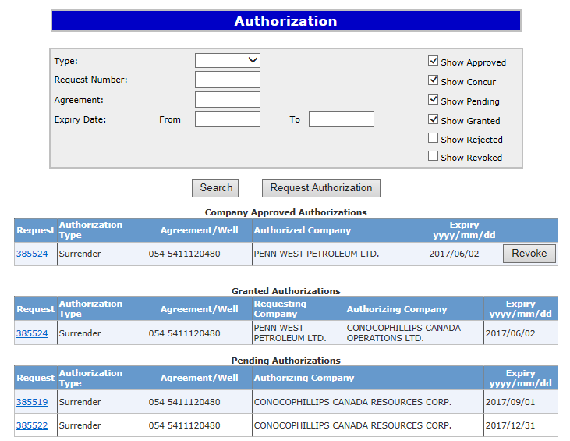
Authorization – Revoke Authorization
Once the request has been completed, accessing the Authorization screen will list: Approved; Concur; Pending; Granted; Rejected; and Revoked Authorizations by choosing the filter buttons, then selecting Search.
An Approved Authorization can be Revoked until the Expiry date of the Authorization.
Filter Buttons
1. Select Search
XYZ Company
XYZ Company
ABC Company
ABC Company
ABC Company

Slide 19
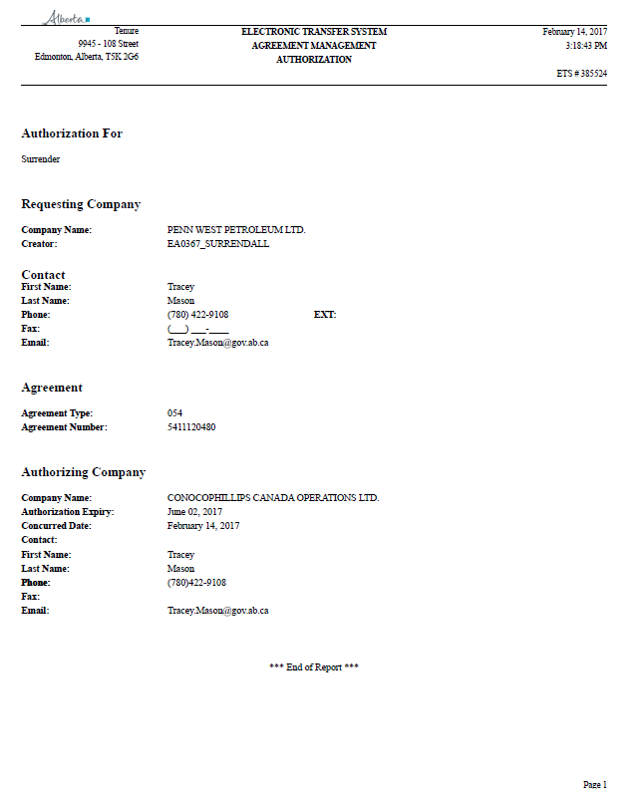
On the Authorization Screen, when you select the Request Number, example 3895524. This will populate a PDF document of the Authorization.
XYZ Company
001
1000
ABC Company

Slide 20
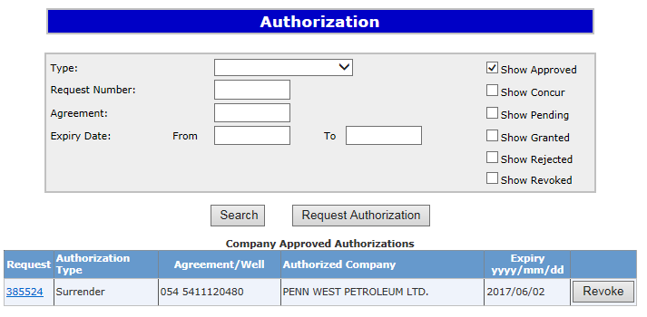
To Revoke an Approved Authorization, select Agreement Management then select Authorizations. Using the Filter buttons select Show Approved agreements, then select Search. Your agreement will populate at the bottom of the screen, select Revoke.
1. Select Show Approved
Filter Buttons
2. Select Search
001 1000
XYZ Company
3. Select Revoke
Upon confirming, ETS will send an email to the requesting company advising that the request that has been revoked.

Slide 21
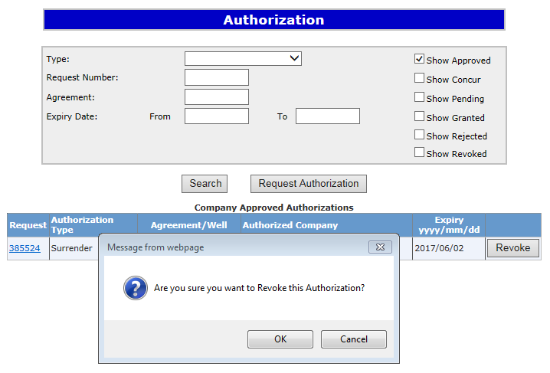
A message box will appear confirming you want to Revoke the Authorization. Select Ok. Once Ok has been selected, the task will be completed.
1. Select OK
Revoke only means the authorization can not be used again; however, it does not revoke previously authorized applications already submitted.

Slide 22
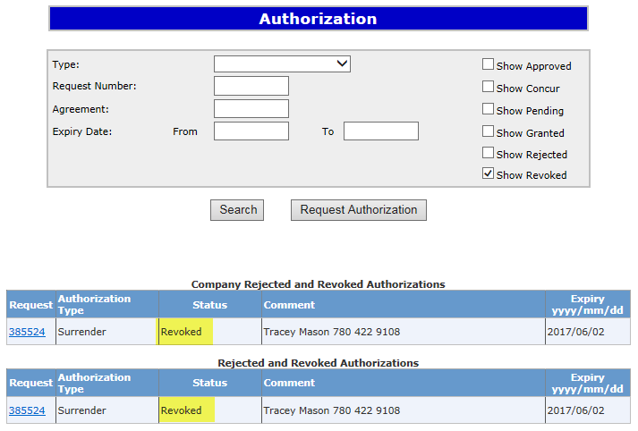
To confirm the agreement has been Revoked, on the Agreement Management Authorization screen, select Show Revoked. All Revoked Authorizations will populate at the bottom of the screen.
1. Select Show Revoked

Slide 23
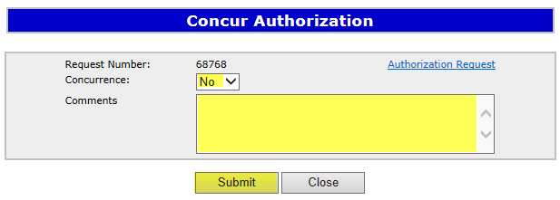
Authorization – Reject Authorization
Follow the same process to select the Authorization to Concur, but select No in the Concurrence dropdown list.
1. Click on the dropdown and select No
2. Enter Comments for rejecting the authorization request
3. Click on Submit
Upon submission of the request, ETS will send an email to the requesting company advising that the request has been rejected.

Slide 24
Resources
ETS Support and Online Learning provides access to relevant guides, courses and other information.
If you have questions, please contact Energy.Rentals@gov.ab.ca
or the PNG Tenure Help Line at (780) 644-2300.

Slide 25

Congratulations!
You have completed the Agreement Management
Authorization
Online Training Course
To access Courses, Guides and Forms for all your ETS Business please see ETS Support and Online Learning.
If you have any comments or questions on this training course,
please contact:
Crown Agreement Management
Helpdesk: (780) 644-2300
Email inquires: ENERGY.Rentals@gov.ab.ca

